Slide 1
Chapter 1

Slide 2
Objectives

Slide 3
Objectives (cont.)

Slide 4
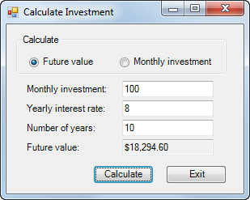
A Windows Forms application running on the desktop

Slide 5
Common types of .NET applications

Slide 6
Visual Studio 2015 Editions

Slide 7
Programming languages supported by Visual Studio 2015

Slide 8
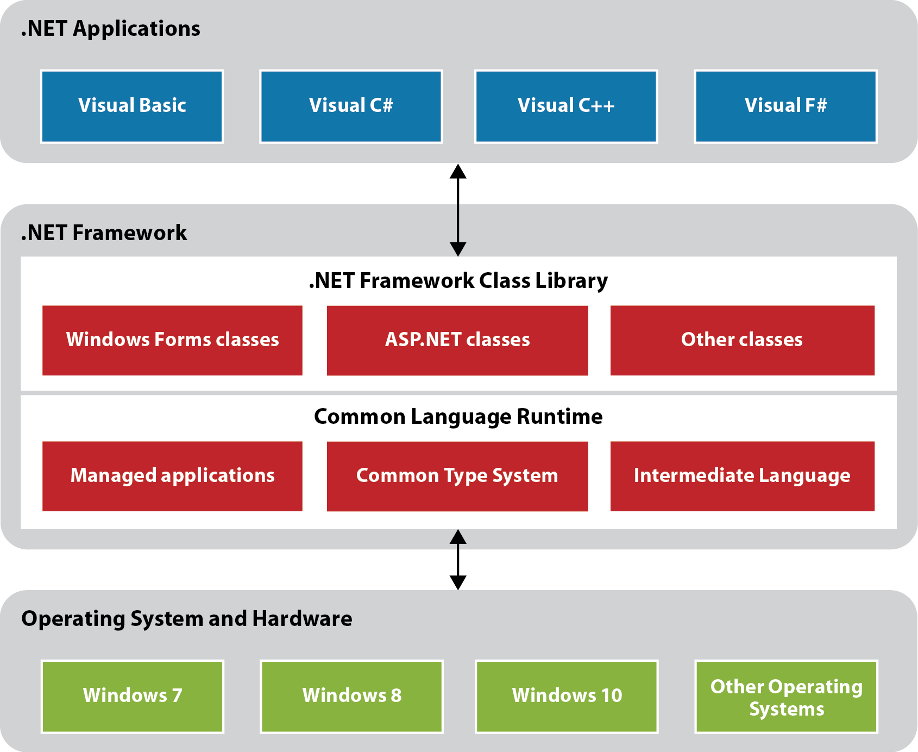
The .NET Framework

Slide 9
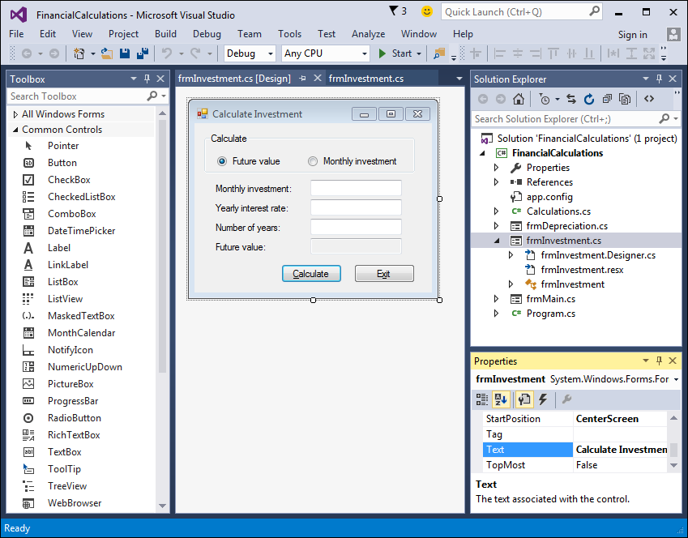
The Visual Studio IDE

Slide 10
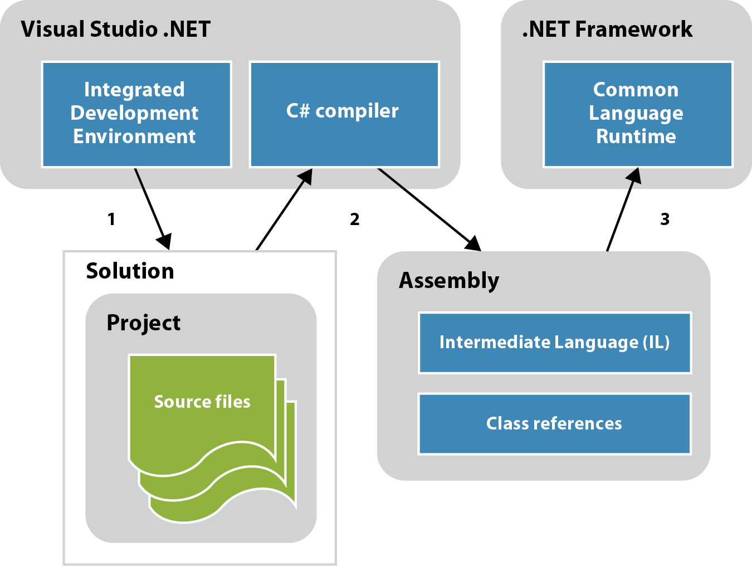
How a C# application is compiled and run

Slide 11
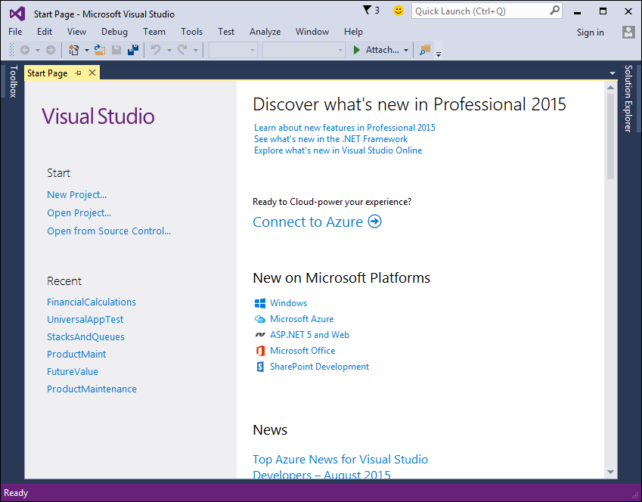
The Visual Studio Start Page

Slide 12
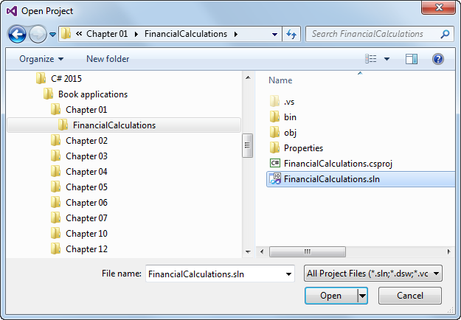
The Open Project dialog box

Slide 13
Project and solution concepts

Slide 14
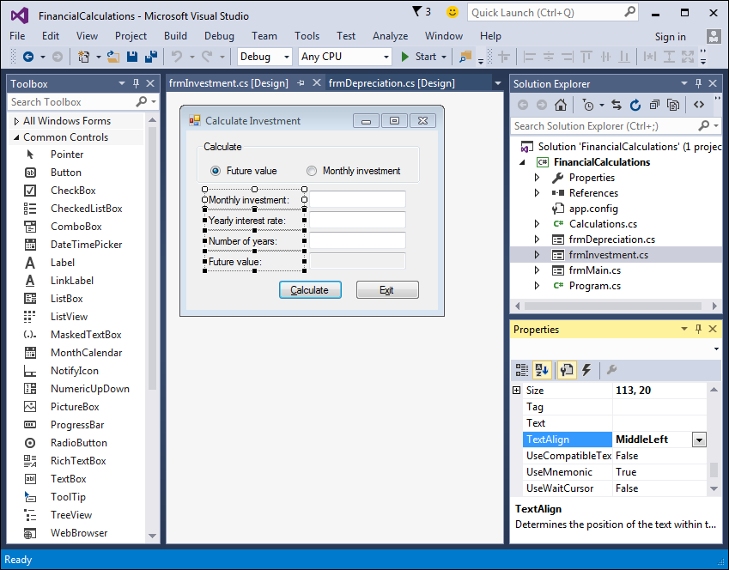
The Form Designer window of Visual

Slide 15
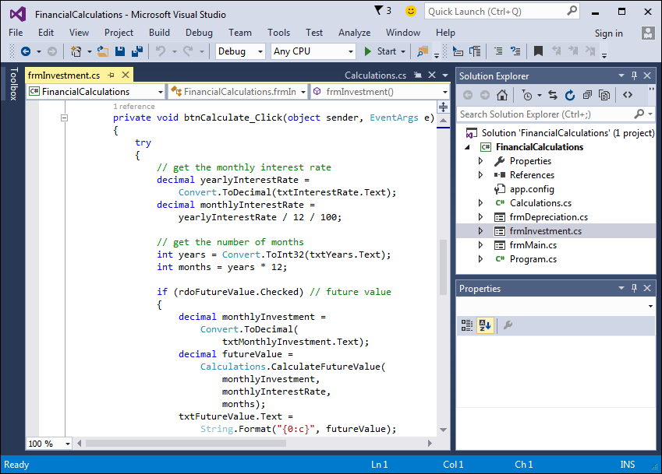
The Code Editor window of Visual

Slide 16
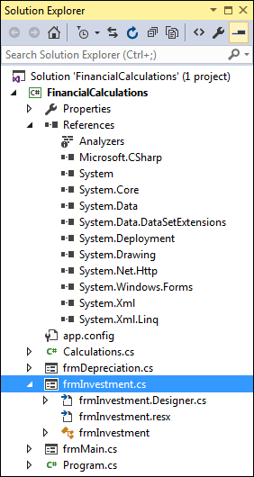
The Solution Explorer

Slide 17
Project files

Slide 18
Project files (cont.)

Slide 19
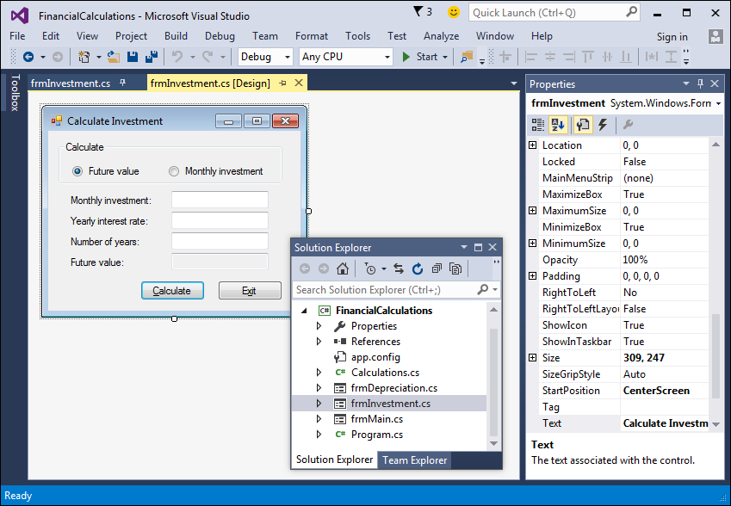
Two floating windows, a hidden window, and a pinned window

Slide 20
How to rearrange windows

Slide 21
How to rearrange windows (cont.)

Slide 22
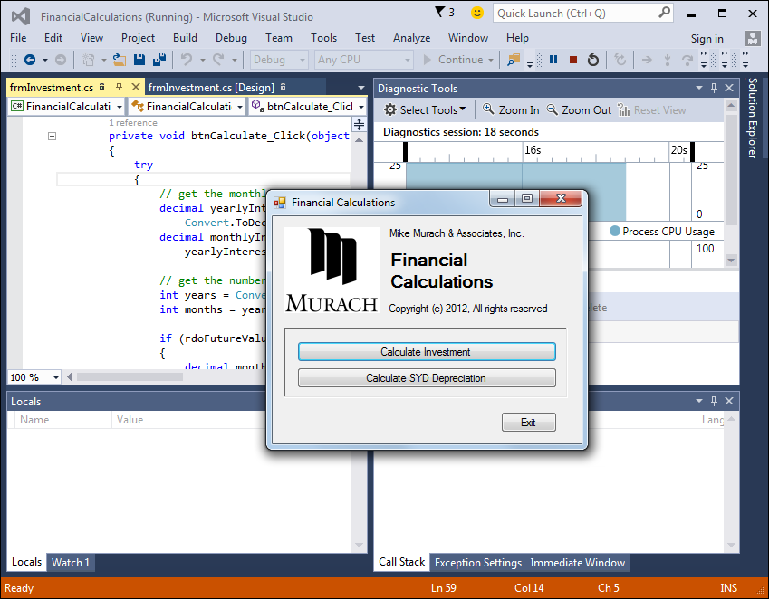
The form that’s displayed when the Financial Calculations project is run

Slide 23
How to build a project without running it

Slide 24
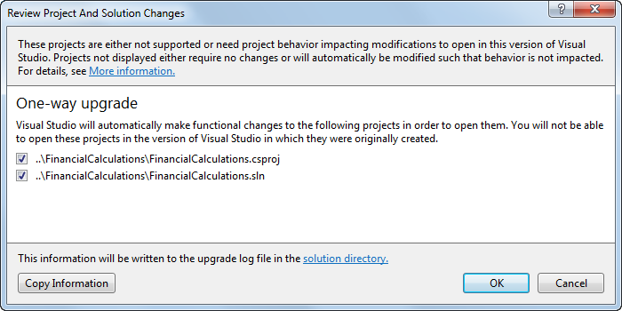
The dialog box for upgrading a project to Visual Studio 2015

Slide 25
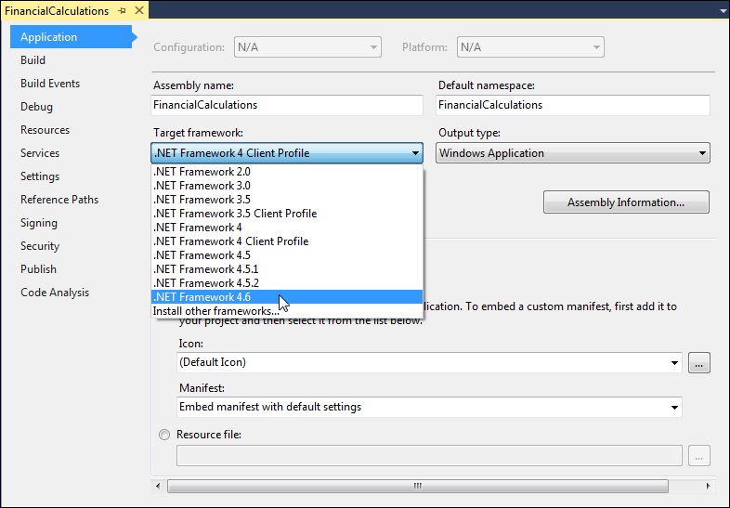
The application properties for a project

